Slide 1
11kW OBC CLLLC CC Forward
Lim Shu Fan
9.5.2022

Slide 2
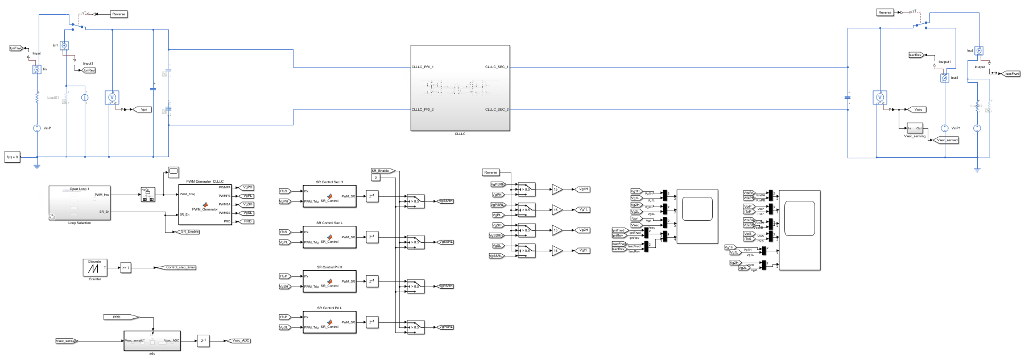

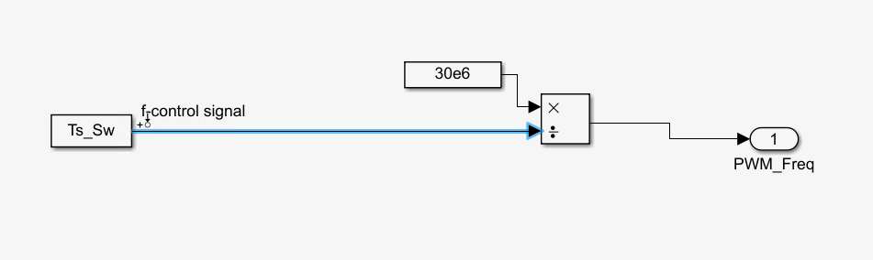
Getting the plant transfer function (Ts to Io for CC in Forward mode)
Output signal– Output current
Input perturbation – switching period

Slide 3
Steps to get Bode plots in MATLAB
Go to Apps -> linearization manager -> select the switching period as input perturbation and output current as output signal
Go to Apps -> Model linearizer -> estimation tab
In Estimation tab -> Model initial conditions -> take simulation snapshot -> put in simulation steady state time at 0.012s
In Estimation tab -> input signal -> select fixed sample time sinestream
Sample time -> 1e-7 (if 50e-6, can only measure frequency range up to 10kHz)
Frequency unit -> Hz
Add new frequencies to the signals -> 10Hz to 100kHz, number of frequencies 30
Select all the frequencies and change amplitude to 25/50 (because +/-5kHz around 83kHz/48kHz)
Select Bode and simulation will start

Slide 4
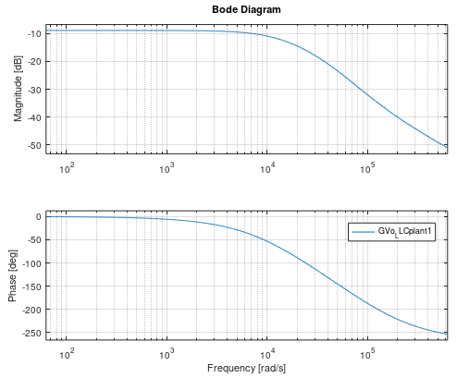
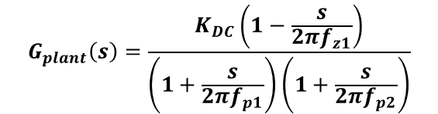
The plant transfer function (open loop sweep) 250V output 9.25kW
$$G_{plant}\left(s\right)=\frac{K_{DC}\left(1−\frac{s}{2πf_{z1}}\right)}{\left(1+\frac{s}{2πf_{p1}}\right)\left(1+\frac{s}{2πf_{p2}}\right)}$$
GDC=-8.89277dB, KDC=10^(GDC/20), fz1= 20kHz, fp1=2.2kHz, fp2=7kHz
Operating point
Vin = 800V
Vout = 250V
Iout = 37A
Fsw = 83kHz

Slide 5
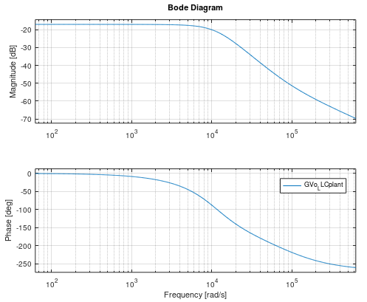
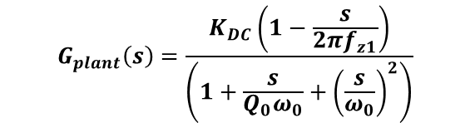
The plant transfer function (open loop sweep) 470V output 11kW
$$G_{plant}\left(s\right)=\frac{K_{DC}\left(1−\frac{s}{2πf_{z1}}\right)}{\left(1+\frac{s}{Q_{0}ω_{0}}+{\left(\frac{s}{ω_{0}}\right)}^{2}\right)}$$
GDC=-17.0763dB, KDC=10^(GDC/20), Q0=0.63, f0=1.8kHz, fz1= 14kHz
Operating point
Vin = 800V
Vout = 470V
Iout = 23.4A
Fsw = 48kHz

Slide 6
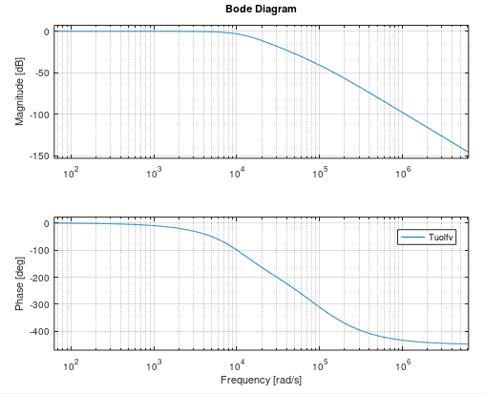
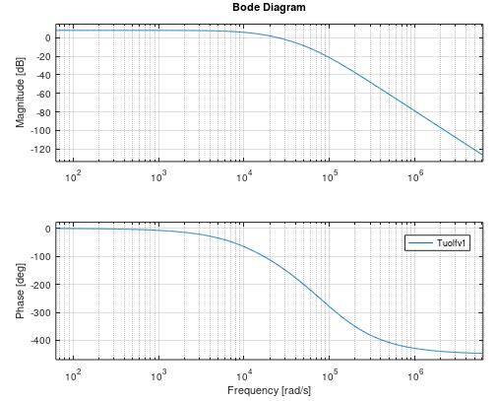
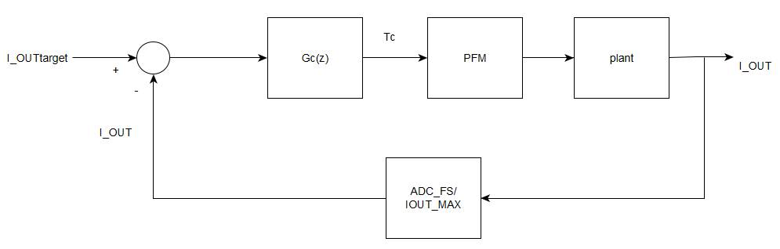
The uncompensated open loop gain at 470V and 250V respectively
Uncompensated loop gain 470V 11kW
Uncompensated loop gain 250V 9.25kW

Slide 7
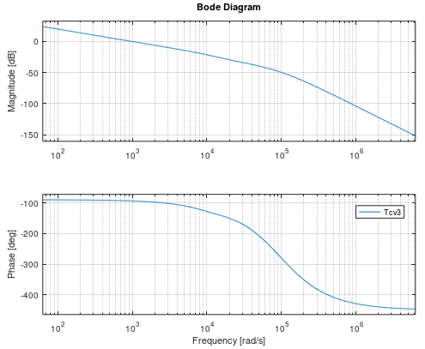
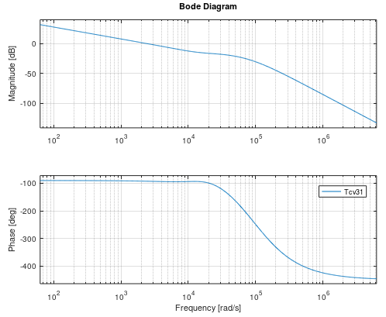
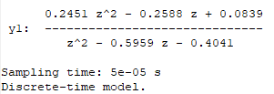
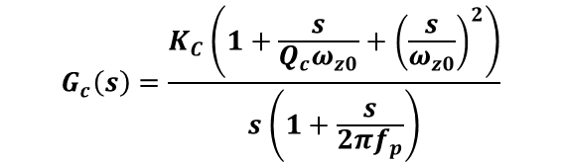
2P2Z compensator design (50us)
Compensated loop gain 470V 11kW
Compensated loop gain 250V 9.25kW
Design Output
Fc =156Hz
PM =86deg
GM=-35dB
Design Output
Fc =398Hz
PM =87deg
GM=-22dB
Design parameters
Fz0 =2.2kHz
Qc =0.63
Fp= 15kHz
Gfc=-60dB
Kc=1/(10^(Gfc/20))
$$G_{c}\left(s\right)=\frac{K_{C}\left(1+\frac{s}{Q_{c}ω_{z0}}+{\left(\frac{s}{ω_{z0}}\right)}^{2}\right)}{s\left(1+\frac{s}{2πf_{p}}\right)}$$
Tustin

Slide 8
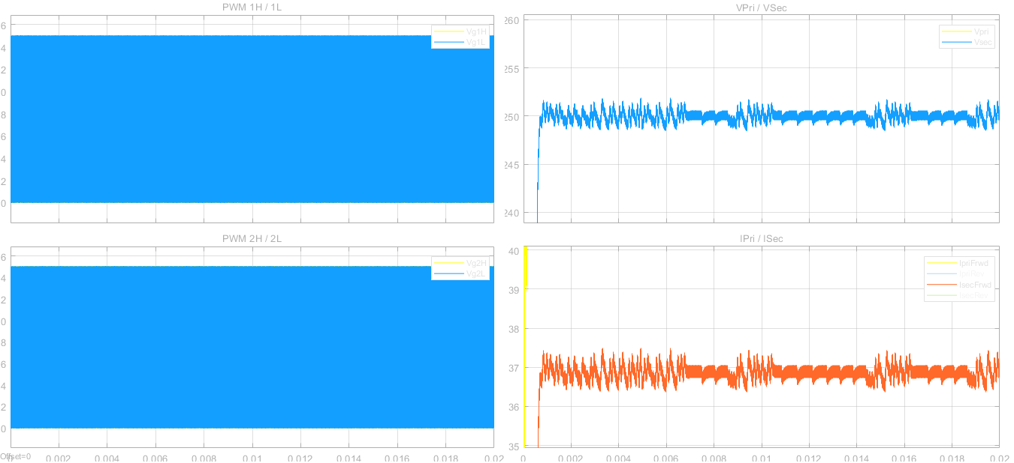
At 800V input, 250V output and 9.25kW,

Slide 9
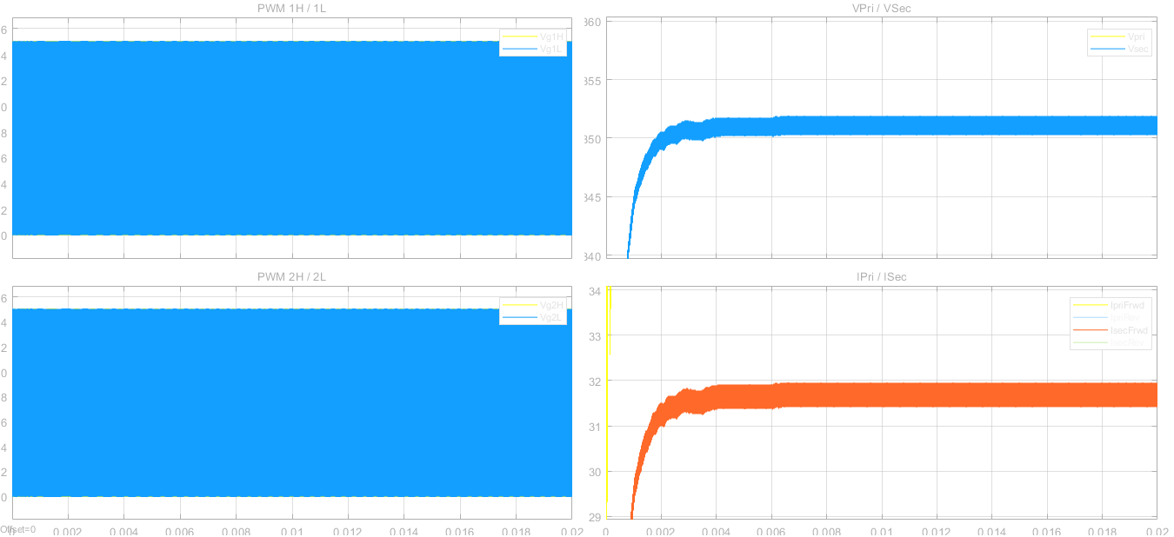
At 800V input, 350V output and 11kW,

Slide 10
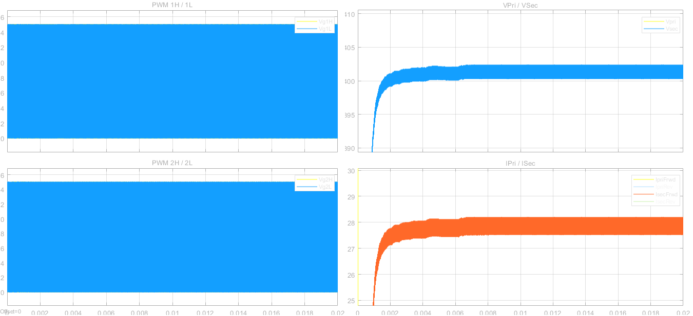
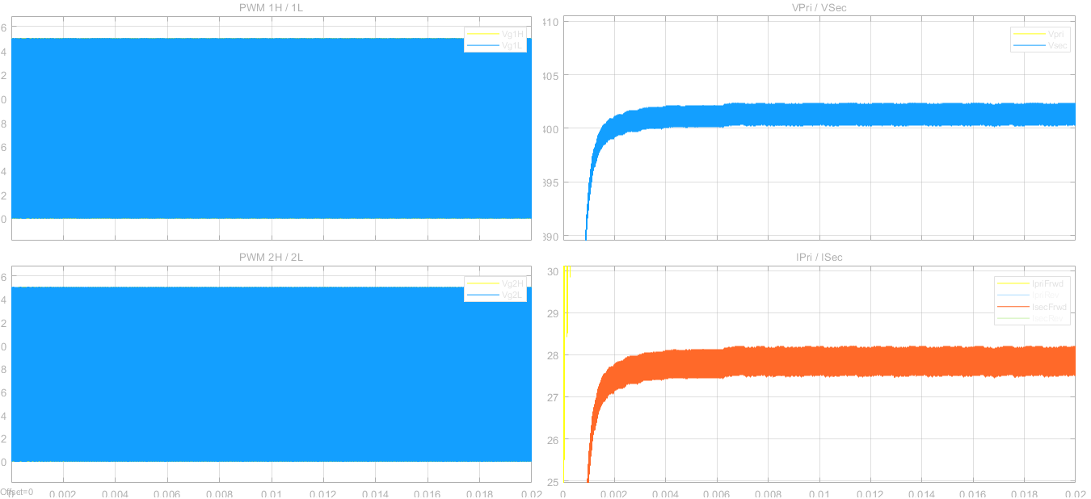
At 800V input, 400V output and 11kW,

Slide 11
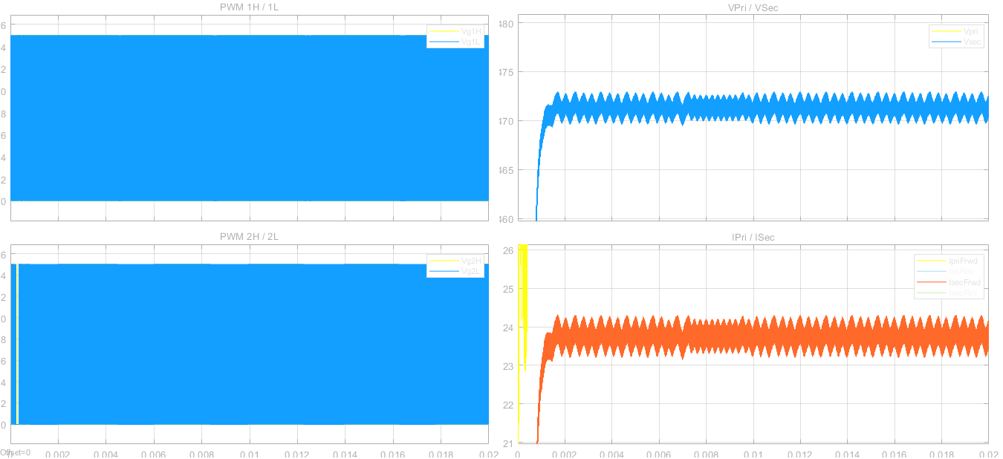
At 800V input, 470V output and 11kW,

Slide 12
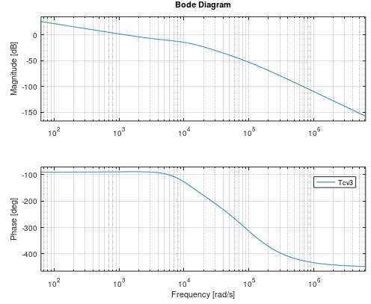
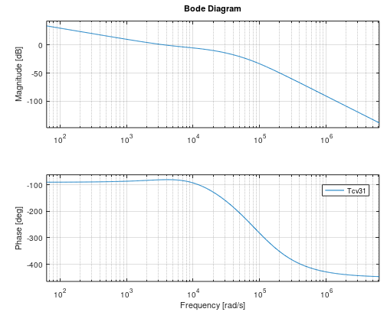
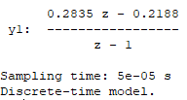

PI compensator design (50us)
Compensated loop gain 470V 11kW
Compensated loop gain 250V 9.25kW
Design Output
Fc =207Hz
PM =91deg
GM=-23dB
Design Output
Fc =635.6Hz
PM =100deg
GM=-17dB
Design parameters
FzL =820Hz
Gfc=12dB
KL=1/(10^(Gfc/20))
$$G_{c}\left(s\right)=K_{L}\left(1+\frac{2πf_{zL}}{s}\right)$$
Tustin

Slide 13
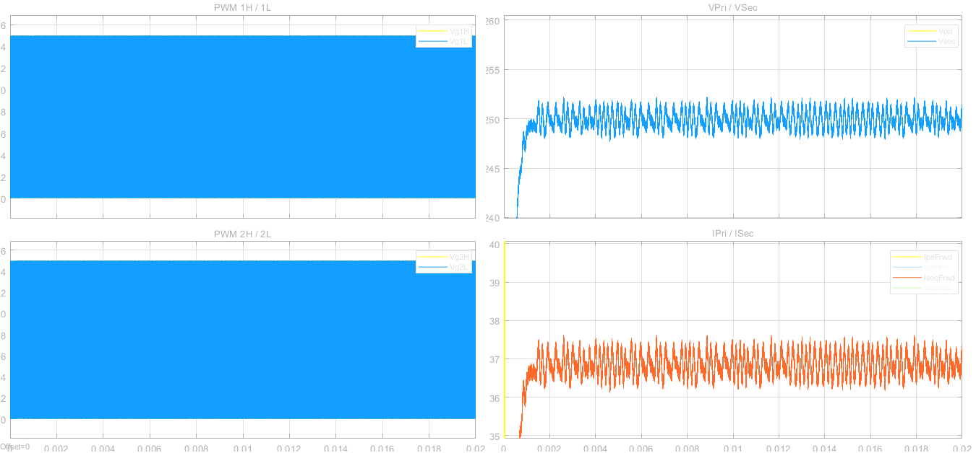
At 800V input, 250V output and 9.25kW,

Slide 14
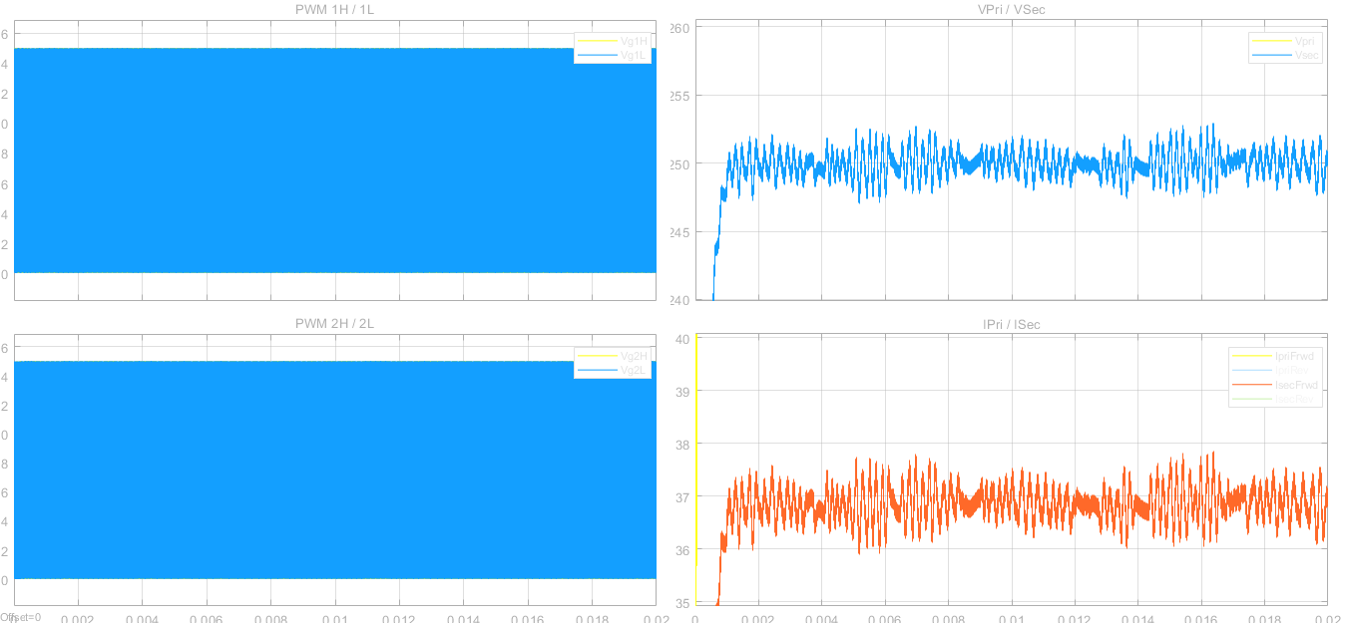
At 800V input with 30Vpp ripples at 120Hz, 250V output and 9.25kW,
Output ripple specs is +/-2% of output voltage.
At 250V, output ripple should be < +/-5V.
Output ripple specs is +/-5% of output current.
At 37A, output ripple should be < +/-1.85A.

Slide 15
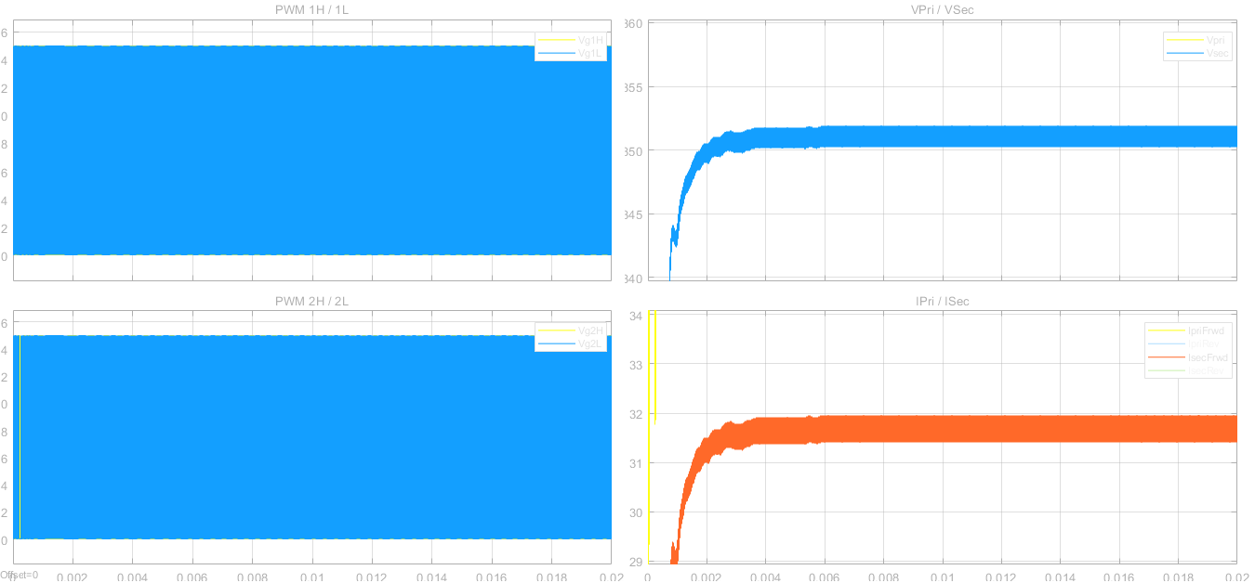
At 800V input, 350V output and 11kW,

Slide 16
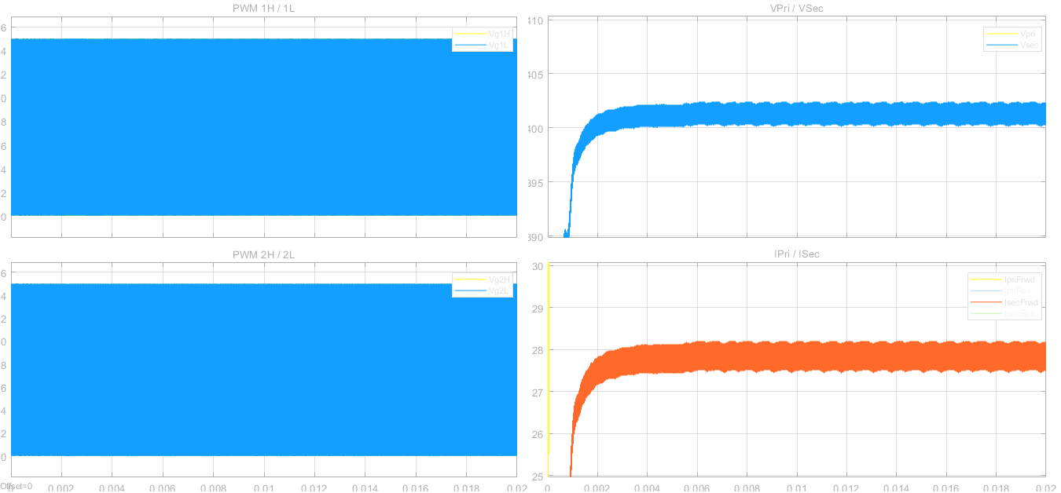
At 800V input, 400V output and 11kW,

Slide 17
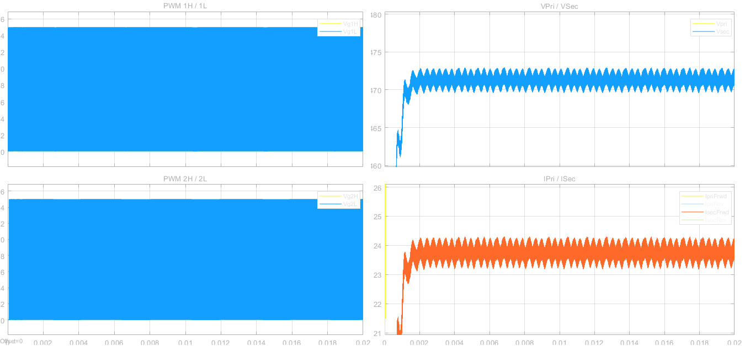
At 800V input, 470V output and 11kW,

Slide 18
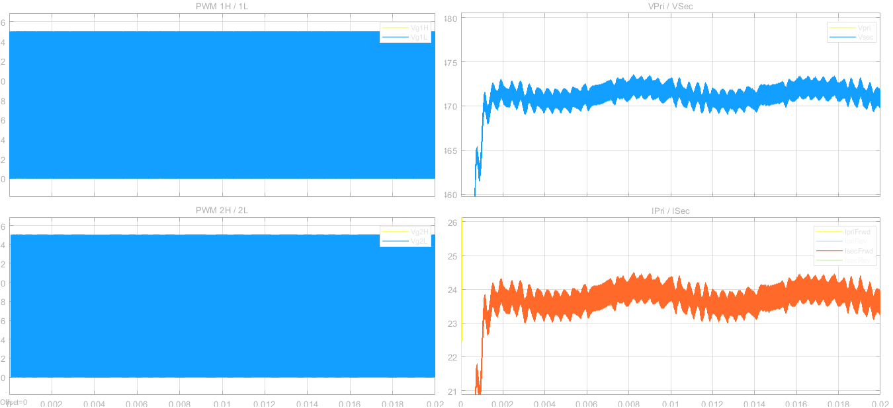
At 800V input with 30Vpp ripples at 120Hz, 470V output and 11kW,
Output ripple specs is +/-2% of output voltage.
At 470V, output ripple should be < +/-9.4V.
Output ripple specs is +/-5% of output current.
At 23.4A, output ripple should be < +/-1.17A.
Marginally passing at high limit.

Slide 19
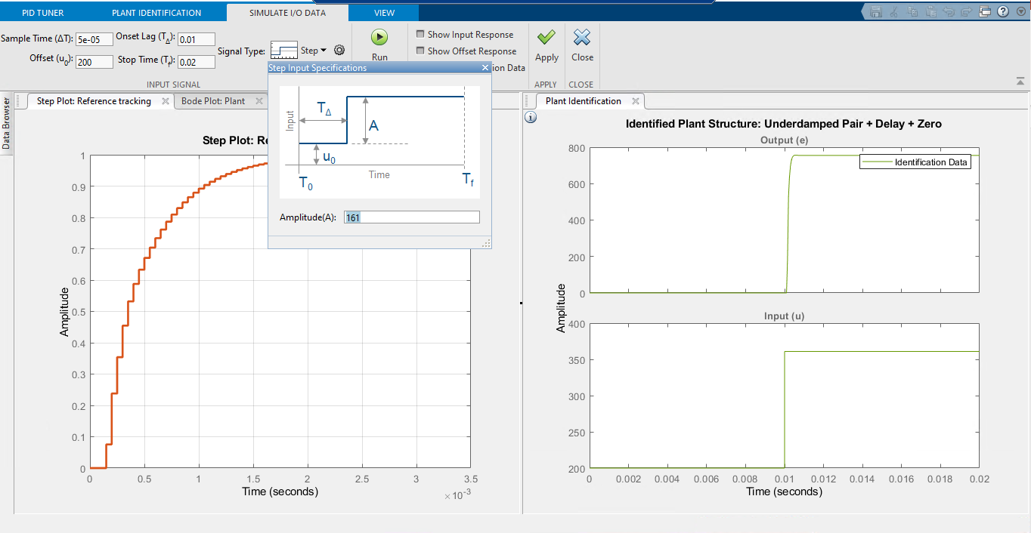
Control design using PID tuner – Settings for simulation run at 470V 11kW

Slide 20
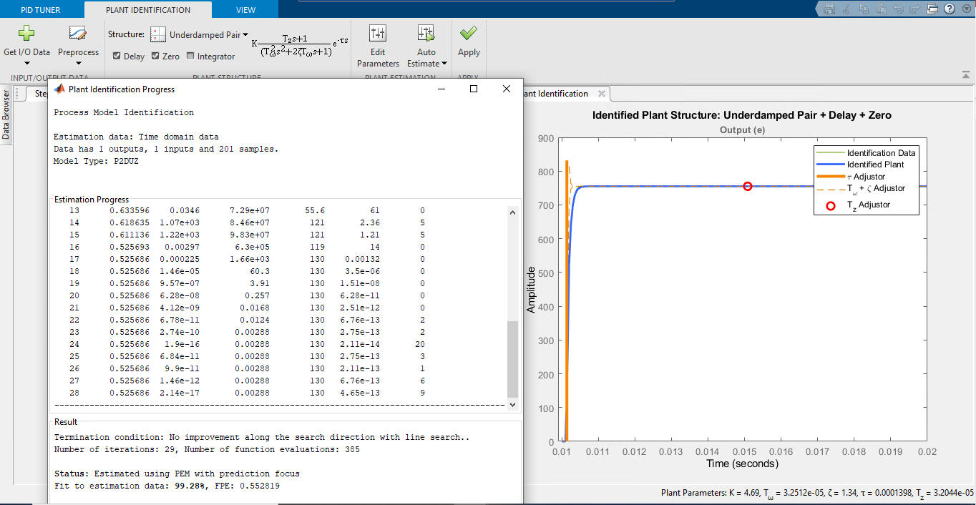
Control design using PID tuner – Plant identification

Slide 21
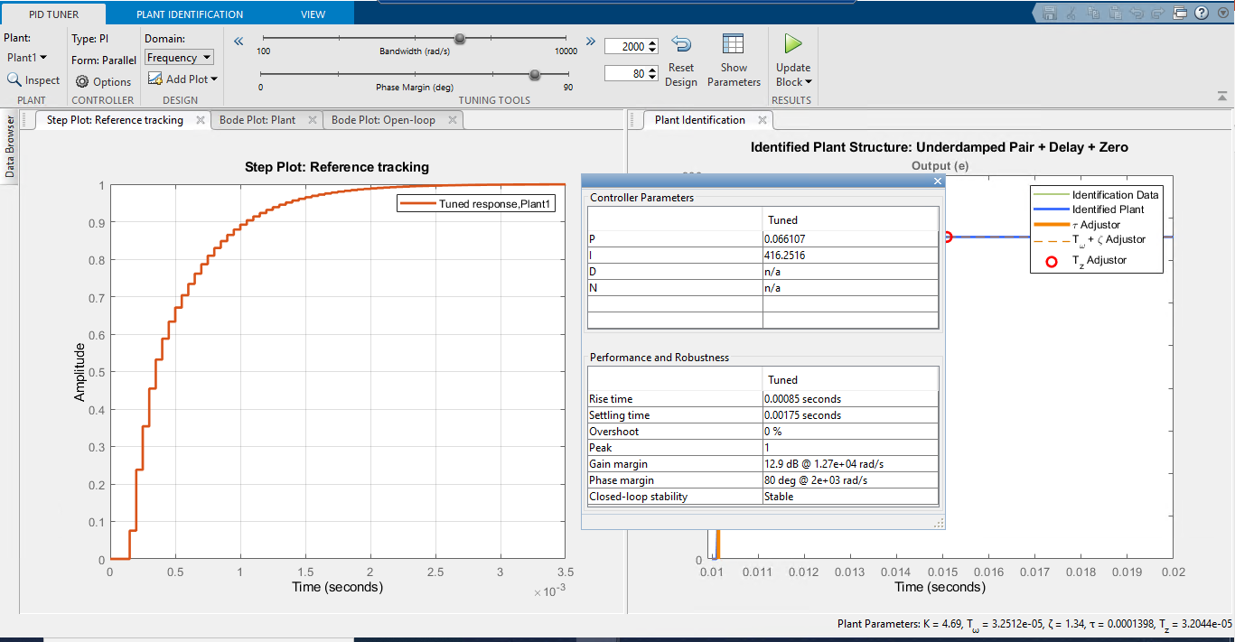
Control design using PID tuner – PID tuning

Slide 22
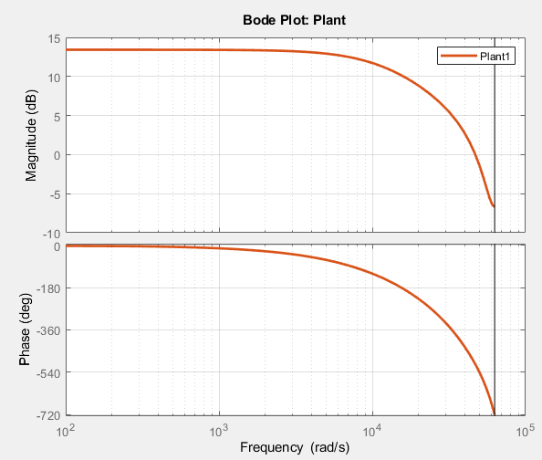
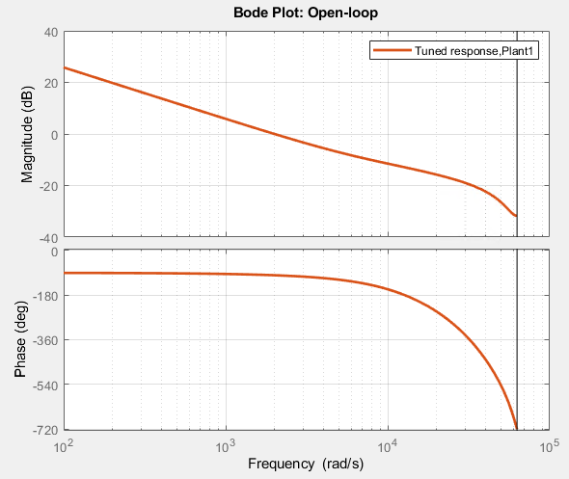
Bode plot of plant and Open loop bode plot

Slide 23
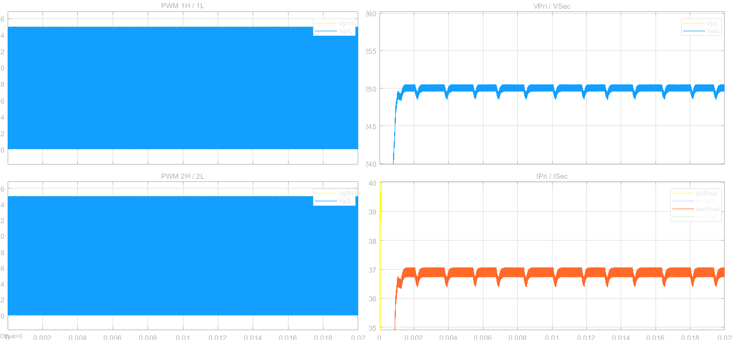
At 800V input, 250V output and 9.25kW,

Slide 24
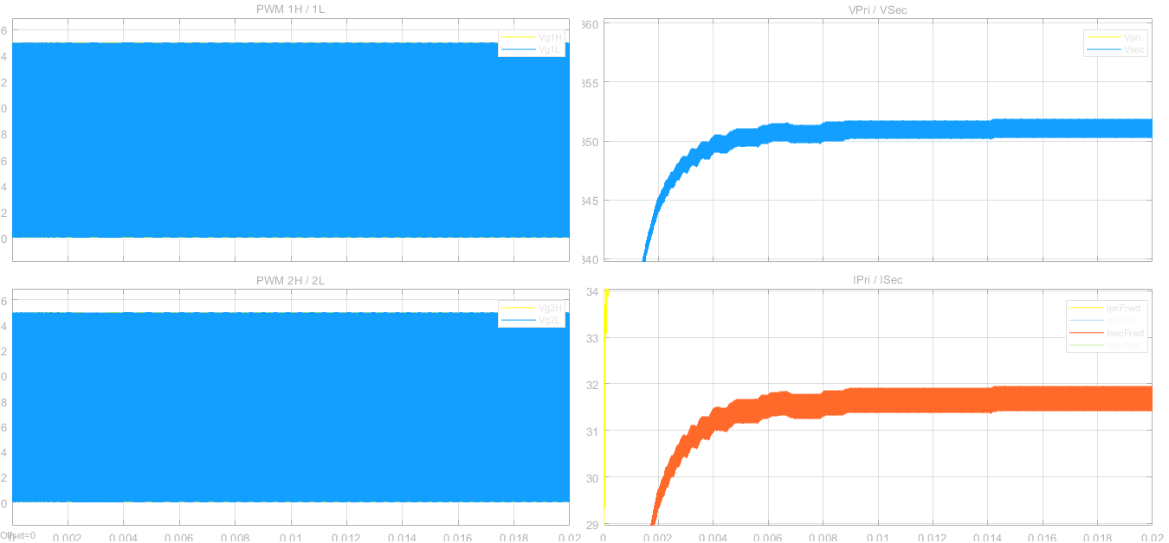
At 800V input, 350V output and 11kW,

Slide 25
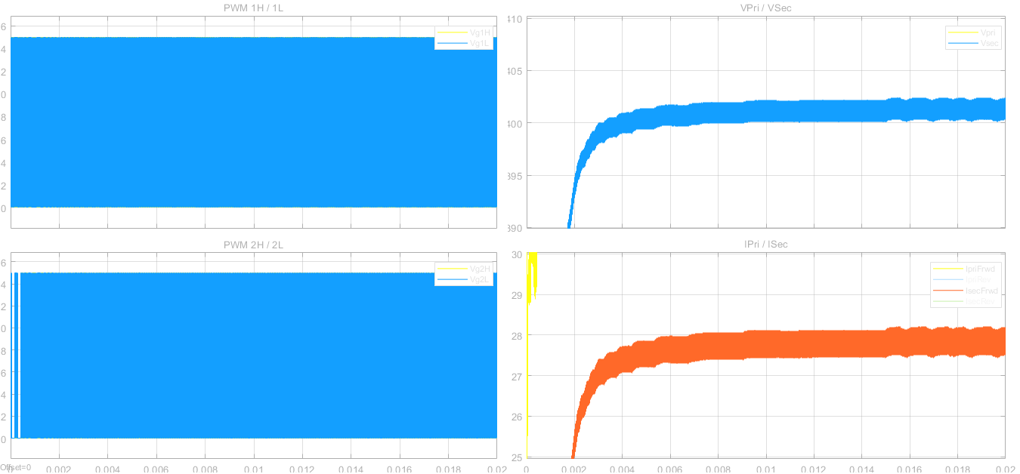
At 800V input, 400V output and 11kW,

Slide 26
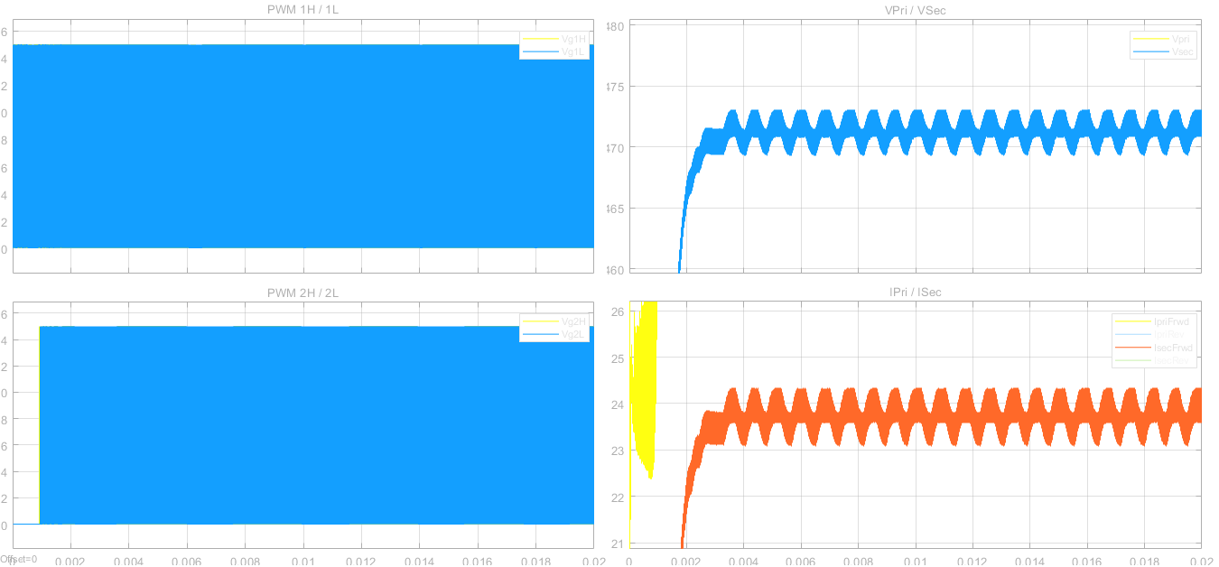
At 800V input, 470V output and 11kW,

